Slide 1


Empirical Security & Privacy, for Humans
UPenn CIS 7000-010
9/9/2025
Security – Risk and uncertainty

Slide 2
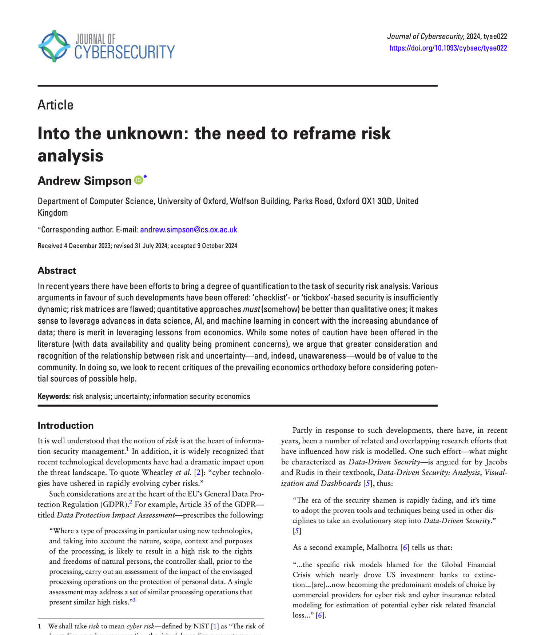
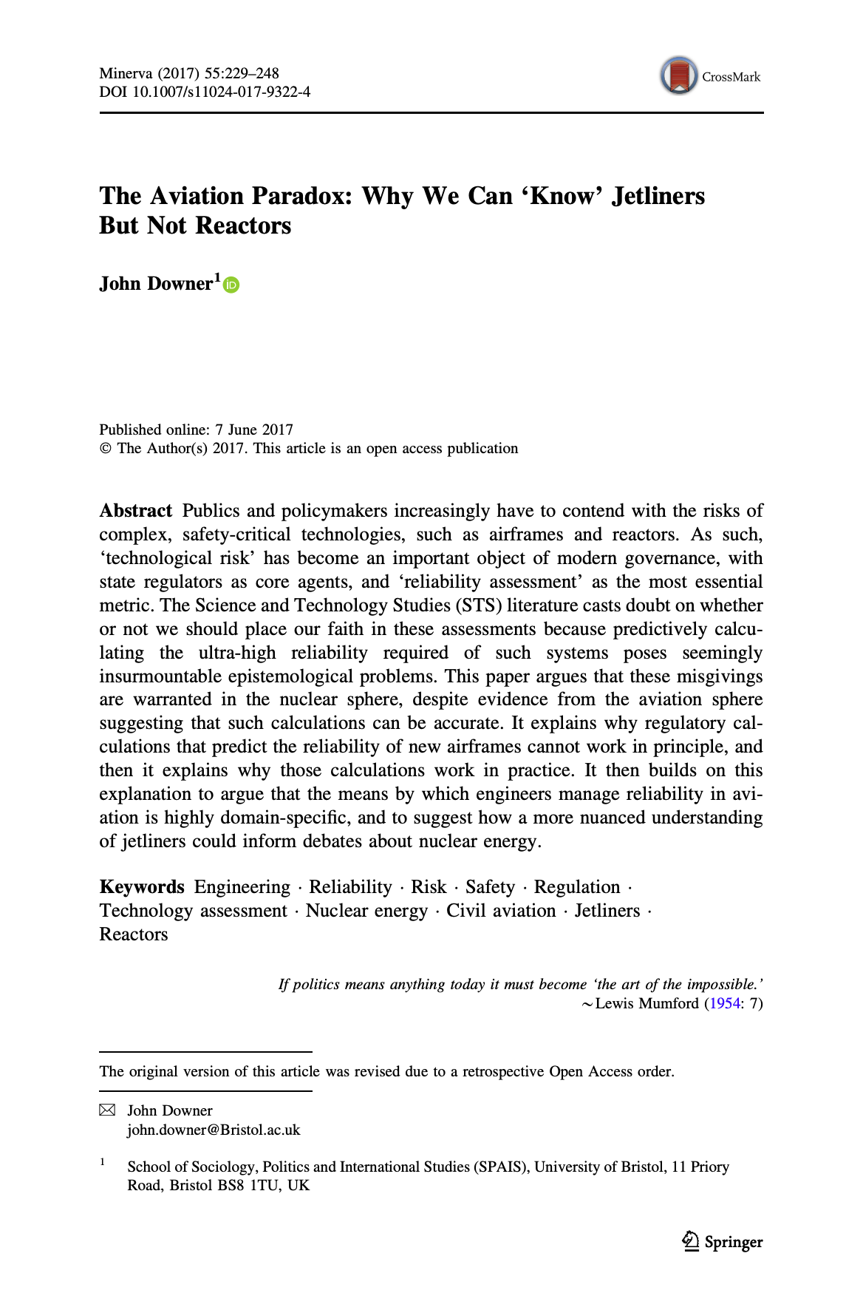
Readings

Slide 3
Readings

Slide 4
Ultra-high reliability assessments
Reliability like security – a negative property.
Forces it to be contextual: You have to define the circumstances under which you agree the bad thing can’t happen, and you have to carefully define the parameters of the bad thing
Predictive reliability assessment goal: 1B hours of failure-free service
Approach: Model-based analysis
Assess individual components inductively
Reason about their combined reliability deductively, using a model
Example: Redundant engines
Single engine failure probability P, based on measurements
Total engine failure of two engines = P²
Assuming engine failures are independent
Notes:
Where did the “billion hours” level of reliability come from? Paper observes that this is basically “certainty”

Slide 5
Ultra-high reliability assessments, questioned
Epistemically dubious!
“There is no way that experts should be able to deduce from tests and models that a yet-unrealized jetliner or reactor will be reliable to the extraordinary levels that they claim.”
Why? We cannot observe the tech in action long enough, or draw on other prior evidence, to extrapolate to the hoped-for conclusion.
1B hours is 114,000(ish) years! Long time to run to test directly
Nevertheless: “A stubbornly suicidal traveler would have to take a random airline flight every day for 19,000 years to stand a better-than-even chance of succumbing to a fatal crash.”

Slide 6
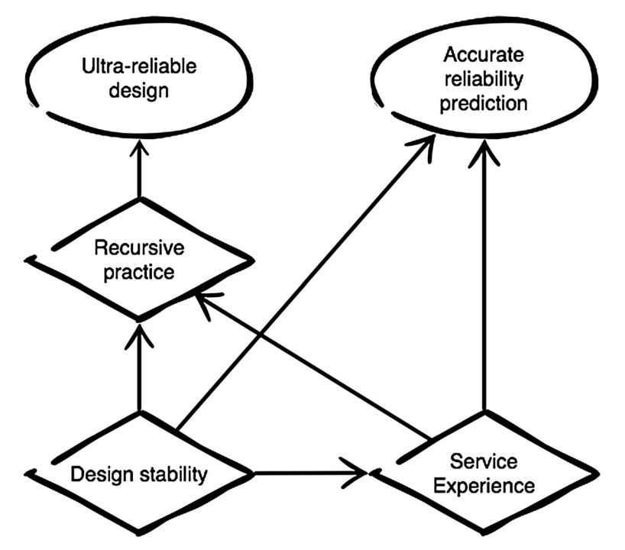
Why it works for (most) civil aviation
Notes:
Also: Military aviation is more risk-taking, and civil aviation learns from its failures (not successes!)
Does FAA acknowledge what it’s really doing?

Slide 7
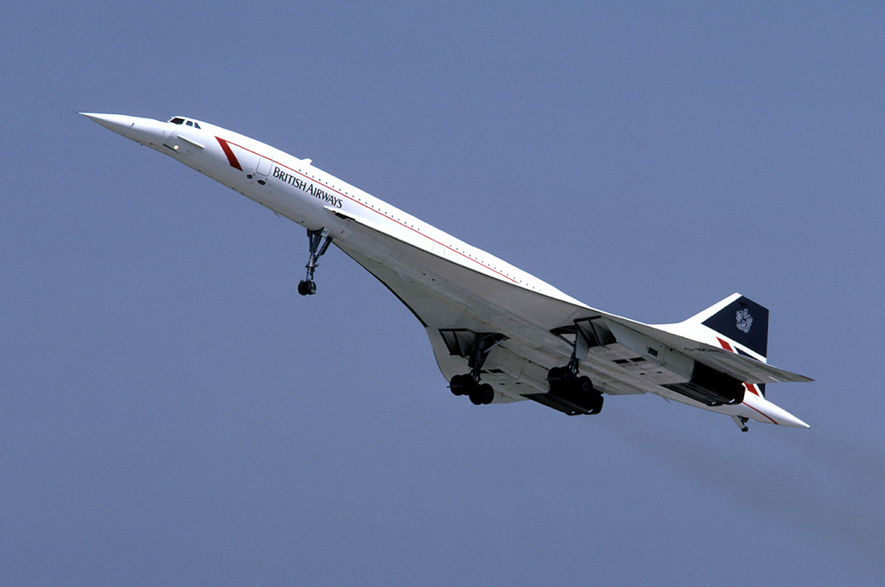
But not the Concorde

Slide 8
But not the Concorde
1 catastrophic failure, July 25, 2000
Very different design
1354 mph cruising speed
‘Double delta’ wing shape
Unorthodox landing gear and a nose that moved
Special heat-resistant alloys
Only 14 planes in operation totaling 50,000 flights over 27 years
Notes:
1 failure in 175000 hours = 5700x below spec of 1 in 1B hours

Slide 9
And not Nuclear
Lessons are learned and improvements made, but do not generalize
Not enough reactors, not enough service time for each
Reactor designs broadly dissimilar

Slide 10
Themes, discussion points
Situation on the ground since this paper was published (2017)
Role and kinds of uncertainty in modeling (next paper!)
Comparing aviation to cybersecurity
Consequences of applying the aviation process, given all this
Thoughts?
Notes:
If nuclear reliability is inherently unknowable, should regulation shift from predicting accidents to planning for resilience (i.e., prepping for failure as if it’s inevitable)?
Aviation achieves recursive practice because accidents are investigated, charted, and (mostly) publicly shared. Is there even a possibility of nuclear energy building an equivalent culture of open learning and sharing of info?
About the paper itself
What about the Boeing MAX failures?
Footnote p. 15 talks about Concorde airworthiness certificate being withdrawn, but I think that happened with the MAX too, right?
Paper assumes that “fly by wire” is sufficiently similar to prior designs: Is that really a good assumption - Software is complex! See Boeing MAX failures …
About the connection to cybersecurity
How is cybersecurity like ultra-high reliability? See pps. 5-6, and apply to cybersecurity instead. Perhaps gives some explanation for the confusion around induction and deduction?
What about data and measuring outcomes?
At least civil aviation is carefully tracked. We know about crashes, their reasons, etc. Is that because they are so few, and thus so easy to track?

Slide 11
Readings

Slide 12
Security is risk, but risks are uncertain
“It is well understood that the notion of risk is at the heart of information security management.”
“in this paper we argue that
(a) greater caution is needed when embracing quantitative approaches and
(b) greater consideration should be given to the relationship that exists between risk and uncertainty”

Slide 13
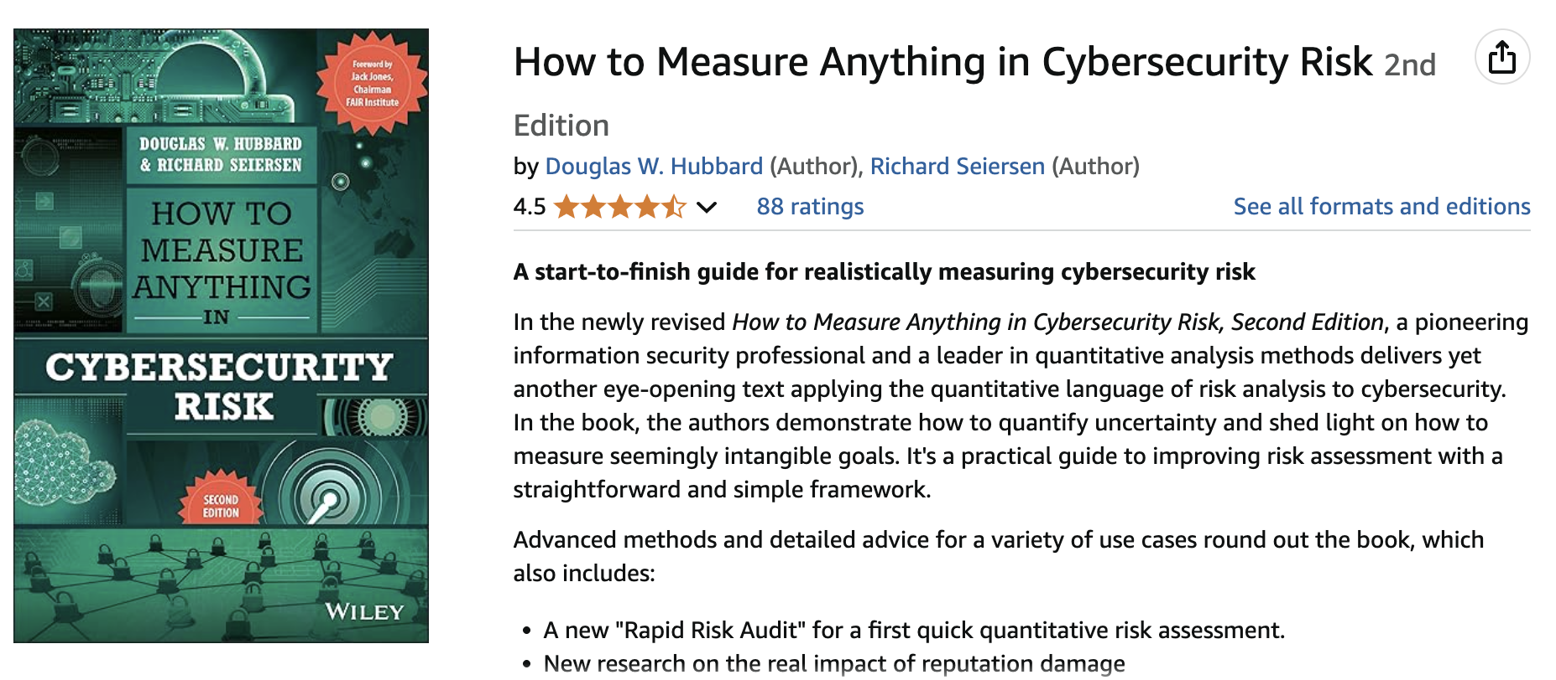

Slide 14
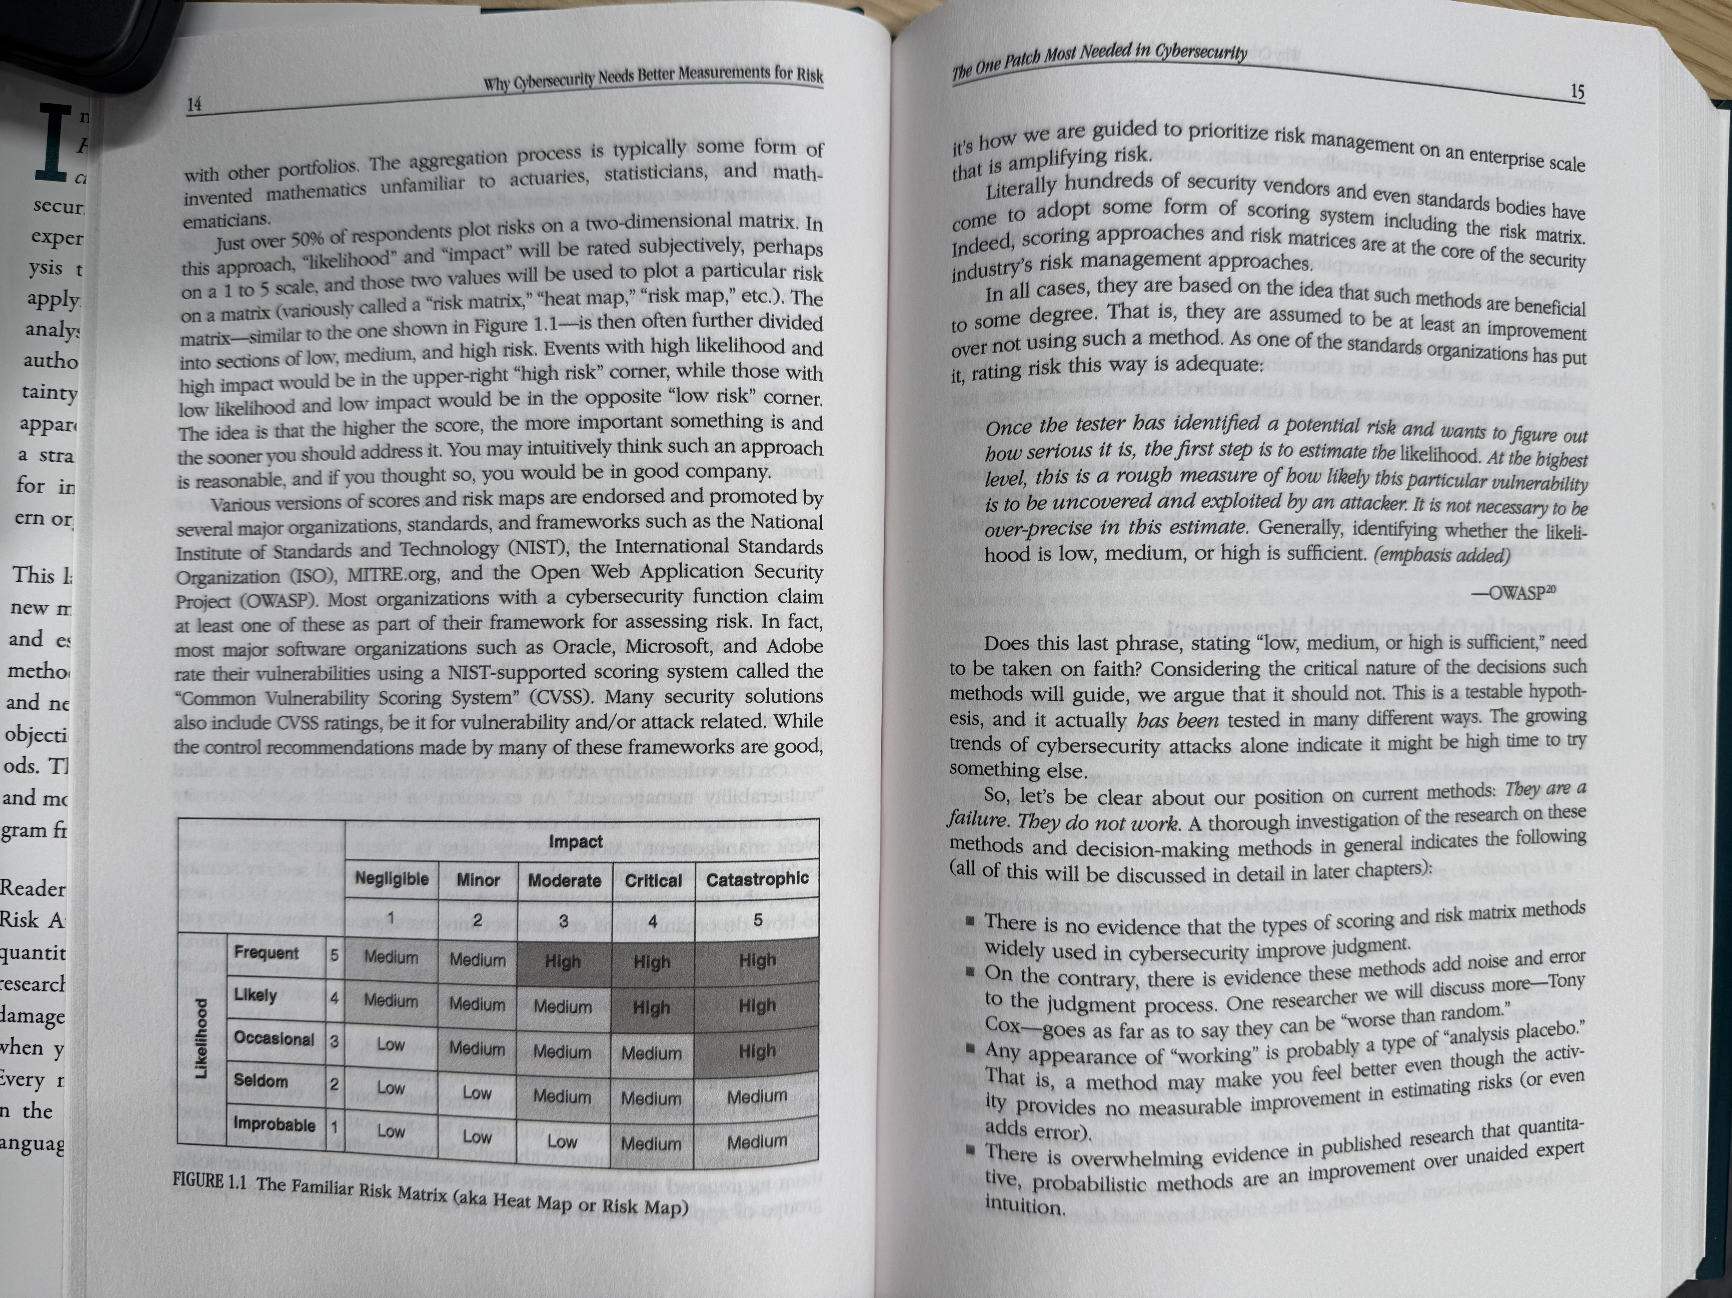

Slide 15
Quantitative risk assessment questioned
Qualitative (“tickbox exercise”) vs. quantitative risk assessment
Problems: Do we have good estimates or data to work from? Does it make epistemic sense, given an active adversary?
Idea: Embrace “Radical uncertainty”. Why?
(a) uncertainty is at the heart of risk management
(b) precision can be spurious,
(c) probabilities can hide uncertainty [what does this mean?!]
(d) while it is undeniably the case that it is essential to plan, it can be dangerous to pretend to know

Slide 16
Themes
Small world vs. large world for modeling
Are probabilities representing knowable outcomes, or uncertainties?
Unawareness (unknown unknowns) vs. uncertainty (known unknowns)
“It is possible to conclude that there is a need, as a community, to reflect upon (a) what lessons we might meaningfully take from economics, and (b) the limits of quantification and modeling.”
Thoughts?

Slide 17
END

